Slide 1
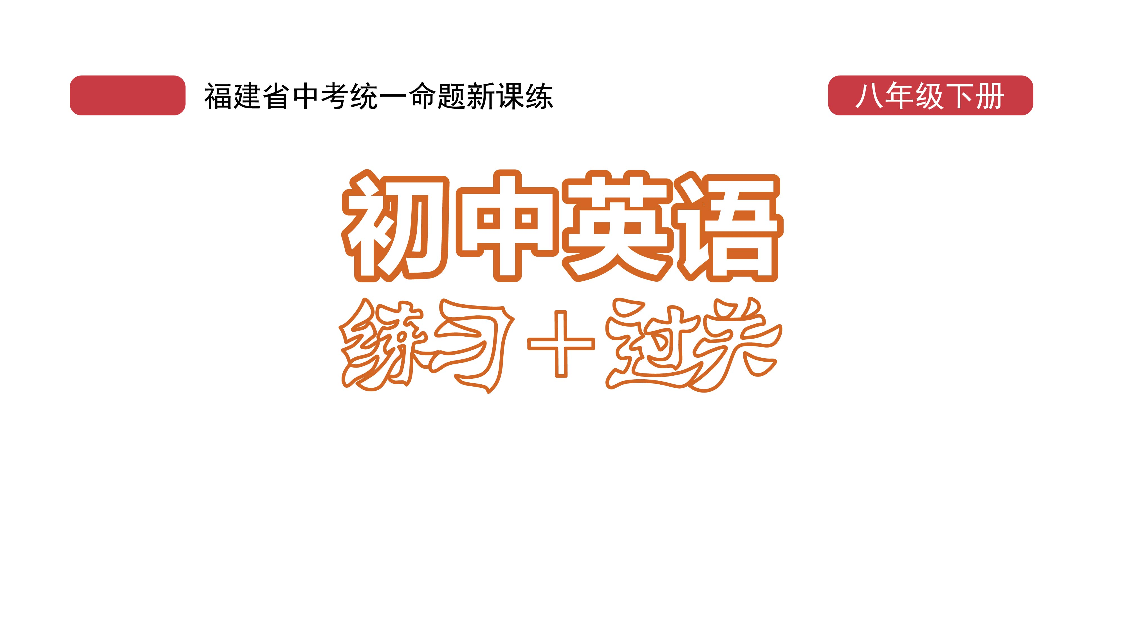
过关测试卷
模块六 第三章 测试卷

Slide 2
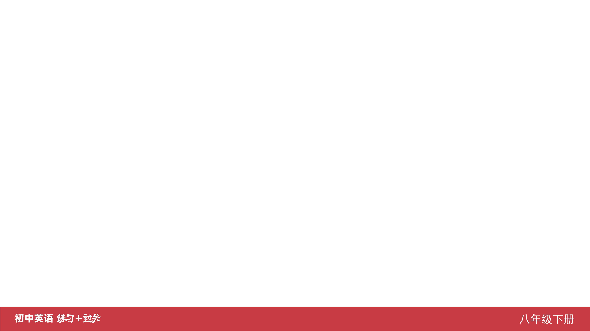
Ⅰ. 听力
1-5 ____________
6-10 ____________
11-15 ____________
16 ____________
17 ____________
18 ____________
19 ____________
20 ____________
CBABA
BACCC
CBCAA
left
white
dark
no
Park

Slide 3
Ⅱ. 选择填空
21-25 ____________
26-30 ____________
31-35 ____________
BCBBC
ACBBC
BBCCC

Slide 4
Ⅲ. 完形填空
36-40 ____________
41-45 ____________
BBCBC
ACBCA

Slide 5
Ⅳ. 阅读理解
46-50 ____________
51-55 ____________
56-60 ____________
61-65 ____________
66-70 ____________
BCBBD
DBACB
BBBDA
DBCCD
BECDA

Slide 6
Ⅴ. 情景交际
71. ____________________________________________
____________________________________________
____________________________________________ 72. ____________________________________________
____________________________________________ 73. ____________________________________________
I don’t agree with you./
I disagree (with you)./
I don’t think so.
You should be careful when riding/when you ride a bike.
How does your father go to work every day, Peter?

Slide 7
Ⅴ. 情景交际
74. __________________________________________
75. __________________________________________
__________________________________________
What do you think of the speech?
Why don’t we go to a/the traffic station to learn more traffic rules?

Slide 8
Ⅵ. 看图写话
76. ___________________________________________
77. ___________________________________________
78. ___________________________________________
___________________________________________
___________________________________________
___________________________________________
Many/Some people got hurt in the traffic accident.
If it doesn’t rain (tomorrow), they will go fishing.
People wear helmets to protect their heads when riding./
When people ride bikes, they should wear helmets
to protect their heads.

Slide 9
Ⅵ. 看图写话
79. ______________________________________________
80. ______________________________________________
______________________________________________
In case of a fire, you/people shouldn’t take the lift.
The boy wrote to his parents as soon as he arrived in New York/America.

Slide 10
Ⅶ. 短文填空
If
largest
famous
its
Colorful
boat
south
climbing
a
beautiful
81 ____________
82 ____________
83 ____________
84 ____________
85 ____________
86 ____________
87 ____________
88 ____________
89 ____________
90 ____________

Slide 11
Ⅷ. 书面表达
Now there are more and more cars on the road, so traffic accidents happen more often.
As students, what should we do to keep safe on the road?
First, we mustn’t play on the road. It’s quite dangerous. Second, we should use the crosswalk and pay attention to traffic lights when we cross the road. Third, we should wear bicycle helmets when riding. Besides, we should walk or ride our bikes on the right side of the road. Finally, always use the sidewalk when we are walking on the road.
If we’re careful and obey the traffic rules, traffic accidents will be fewer.

Slide 12
